Slide 1
Module 5 Physical Design and Governance of Data Warehouses
Lesson 2: Scalable Parallel Processing Approaches
Notes:
Welcome to Lesson 2 of Module 5 on Physical Design and Governance of Data Warehouses
Opening question
How does parallel processing in Hadoop differ from parallel database processing?
What does the name Hadoop mean?

Slide 2
Lesson Objectives
Discuss importance of scalable parallel processing
Explain Hadoop components
Discuss usage of Hadoop for data integration
Notes:
Lesson 2 covers architectures for scalable parallel processing.
Objectives:
Understand the growing importance of parallel processing and distributed file systems, particularly Hadoop for data integration tasks

Slide 3
Timeline of Scalable Parallel Processing
Origins
Project Nutch (2002)
Google File System (2003)
Hadoop
Open source project (2005)
Cloudera founding (2009)
Map Reduce paper (2004)
Hadoop 2 (2013)
Notes:
Hadoop history: https://gigaom.com/2013/03/04/the-history-of-hadoop-from-4-nodes-to-the-future-of-data/
Apache Nutch, an open source web search engine
Map Reduce was a Google algorithm
Maintained by the Apache Foundation
Hadoop was created by Doug Cutting and Mike Cafarella in 2005. Cutting, who was working at Yahoo! at the time, named it after his son's toy elephant..
Cloudera was the first commercial Hadoop company
Spawned dozens of startups and hundreds of millions of venture capital since 2008
Hadoop 2: open

Slide 4

Open source project with commodity components
API and services for parallel processing and job management
Distributed file system
Extensible for multiple task models
Notes:
Scalable parallel processing for big data
Uses distributed file system to support parallel processing
Services
Automatic parallelization
Load balancing
Fault tolerance for failures
Network and disk transfer optimization
Only one task type supported in first version: processing of <key, value> pairs
Somewhat tedious to setup and program but improved tools are being developed
Many parallel processing solutions for enterprise DBMSs but mainly focused on query processing

Slide 5
Hadoop Evolution
Notes:
HADOOP 2
What’s New
Sanjay R adia and Suresh Srivinas
February 2014 Vol. 39, No. 1 (www.usenix.org)
Hadoop evolution
Single task type in Hadoop 1: MapReduce on <key, value> pairs
Hadoop 2: resource negotiator (YARN) to support extensible task types with different data formats

Slide 6
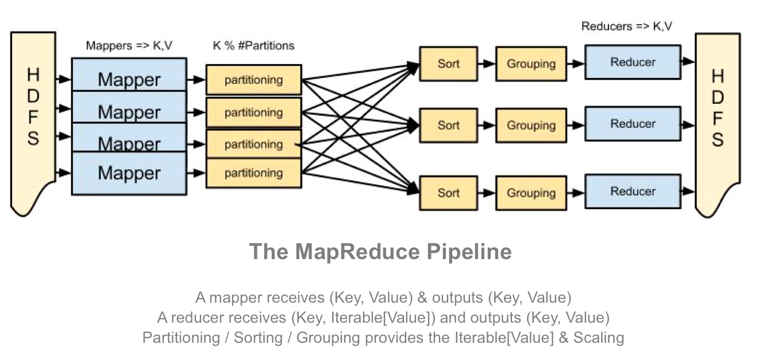
MapReduce Framework
Notes:
From: http://blog.matthewrathbone.com/2013/04/17/what-is-hadoop.html
MapReduce was developed by Google in the early 2000s.
API and services for managing parallel execution of workflows
Batch processing support only
Map: extract important parts of input
Reduce: aggregate, filter, or transform
Default partitioning, sorting, and grouping
Dependency free
No dependency between any pair of functions of the same task.
No need to share state
Easy distribution of pipeline to nodes
Example MapReduce
Map: extract 5 word sequences from web pages
Reduce: Combine counts for each identical 5 word sequence if count is large enough
Useful in many tasks in Google’s web computing
Count of URL access frequency: map extracts URLs and reduce adds access counts for the same URL

Slide 7
MapReduce Example
Notes:
This diagram depicts a simple example of a MapReduce process. The MapReduce process splits text input, maps the split input into <key,value> pairs, sorts the pairs, and reduces the sorted pairs by counting the number of occurrences of each word. Twitter applies this type of MapReduce process to text files containing hundreds of millions of tweets per day.

Slide 8
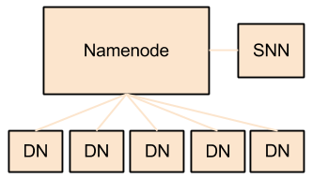
Distributed File System
Notes:
From: http://blog.matthewrathbone.com/2013/04/17/what-is-hadoop.html
Hadoop Distributed File System:
File system layer for large distributed systems
Optimized for throughput
Components:
Namenode: controller for the cluster, containing all meta such as blocks in each data node
SNN (Secondary Name Node): maintains log and periodic filesystem copies for reliability
Data Node: stores data; potentially thousands of data nodes

Slide 9
Extensions to Big Data Processing
Improved performance and new tasks
Distributed, in-memory data sets in Apache Spark
Analytic query processing in Apache Hawq
Support for SQL queries, streaming analytics, data integration, and graph computations in Spark and Hawq
Notes:
The big data parallel processing approach initially developed in Hadoop has been extended for improved performance and new tasks. On the performance side, Apache Spark, another open source project, provides distributed in-memory data sets (known as Resilient Distributed Datasets) to reduce overhead of intermediate file operations in Hadoop 2. Apache Hawq improves performance on analytic queries by reducing storage of intermediate results and degradation due to disk failures. On the task side, Hadoop 2, Spark, and Hawq provide programming interfaces to support SQL queries, streaming analytics, data mining, data integration, and graph computations. A new segment of the software industry has adopted and extended big data parallel architectures, funded by large levels of investment capital.

Slide 10
Summary
Scalable, reliable parallel processing using commodity components
Wide usage of Hadoop 2 open source project
Growing importance of Hadoop for extended data integration
Notes:
Much vendor innovation especially for materialized views, bitmap indexing, architectures, appliances, and cloud services
Hadoop is a strong trend embraced by many vendors

